Slide 1

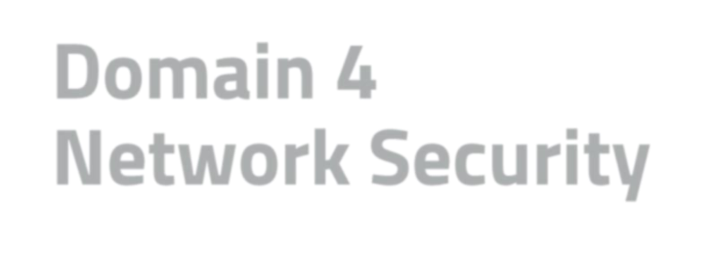
Domain 4 Agenda
Domain 4 Network Security
Module 1: Understand Computer
Networking
Module 2: Understand Network (Cyber)
Threats and Attacks
Module 3: Understand Network Security Infrastructure
Module 4: Summary and Review

Slide 2
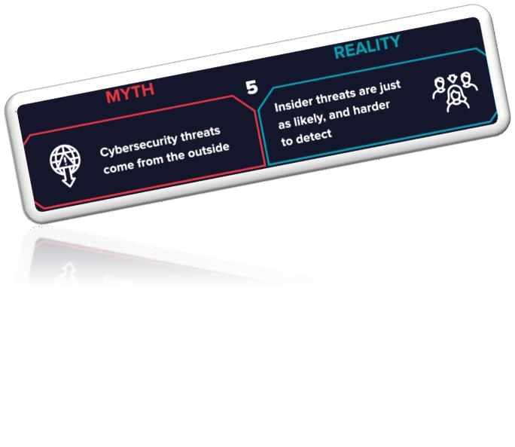


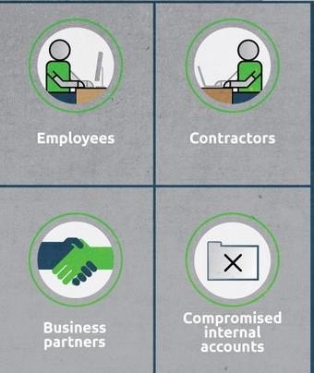
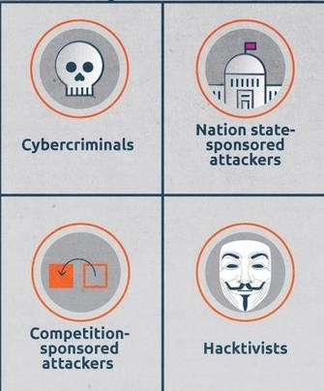

Threats Sources
Insider Threats
Outsider Threats
3

Slide 3

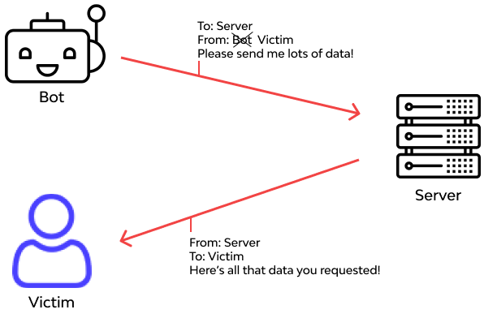

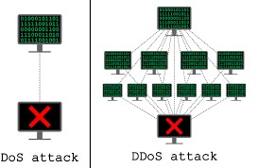



Threats Examples
⦿ Spoofing attacks: Faking the sender address (using a falsified identity) of a transmission to gain illegal entry into a secure system.
⦿ Denial-of-service attack / Distributed Denial-of-
service attack (DoS/DDoS) attacks
The prevention of authorized access to resources or the delaying of time-critical operations
4

Slide 4

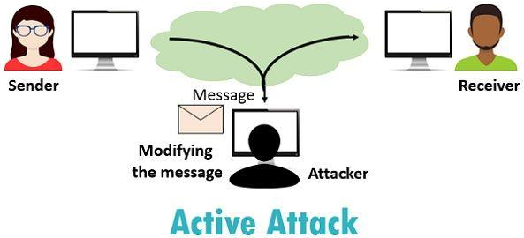
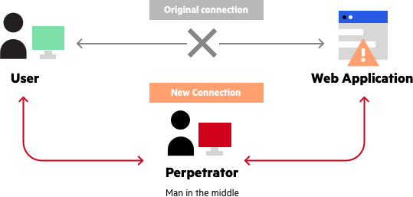

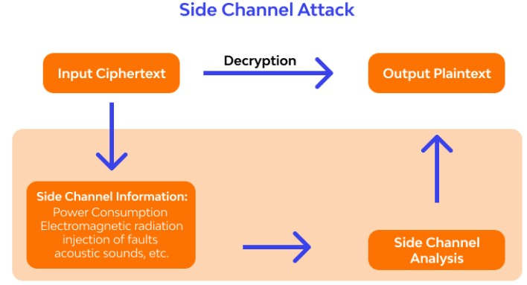
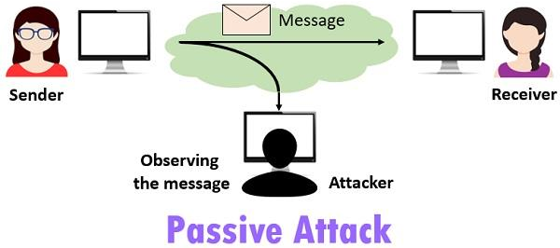

Side-Channel attack vs On-Path attack
On-Path attack
Attackers place themselves between two devices, to intercept or modify information that is intended for one or both endpoints.
Example: MITM
Man-In-The-Middle (MITM) attack
Side-Channel attack
A passive, noninvasive attack to observe the operation of a device. Methods include power monitoring, timing and fault analysis attacks.
Example: Collecting & analyzing leaked information from a physical cryptosystem

Slide 5
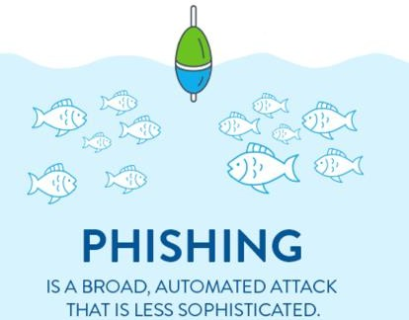
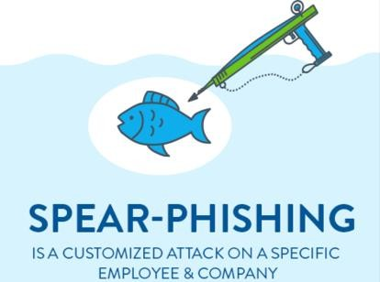

Phishing vs Spear Phishing
⦿ Phishing
⌾ An attack that attempts to misdirect legitimate users to malicious websites through the abuse of URLs or hyperlinks in emails.
⦿ Spear Phishing
⌾ Unlike Phishing, a Spear Phishing attack targets a specific individual or set of individuals rather than sending generic messages to many users in the hope that one falls for the trick.

Slide 6
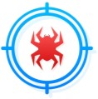



Virus vs Worm vs Trojan
Virus
A virus is a self-replicating piece of malicious code that spreads without the consent of a user, but frequently with their assistance (a user has to click on a link or open a file).
A virus connects itself to another
software or computer program to
harm computer system
Worm
A worm contains the same destructive potential as other malicious code objects with an added twist—they self-replicate and propagate themselves without requiring any human intervention.
A computer worm can spread copies of itself from computer to computer.
Trojan
A trojan is a computer program that gets access to a computer or system by appearing to be harmless but is designed to do something damaging.

Slide 7

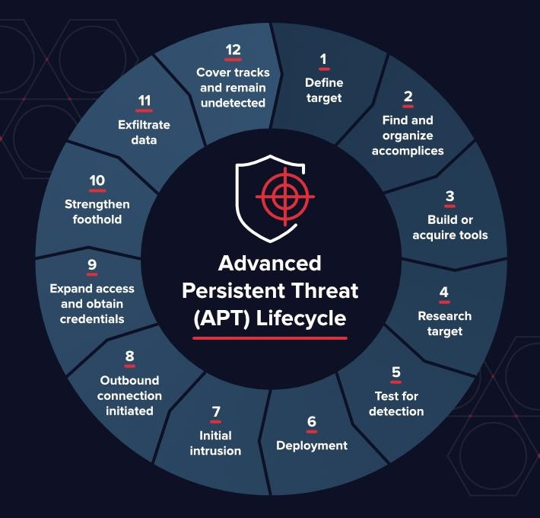

Advanced persistent threat (APT)
Advanced Persistent Threat (APT) refers to threats that demonstrate an unusually high level of technical and operational sophistication spanning months or even years.
APT attacks are often conducted by highly organized groups of attackers.

Slide 8
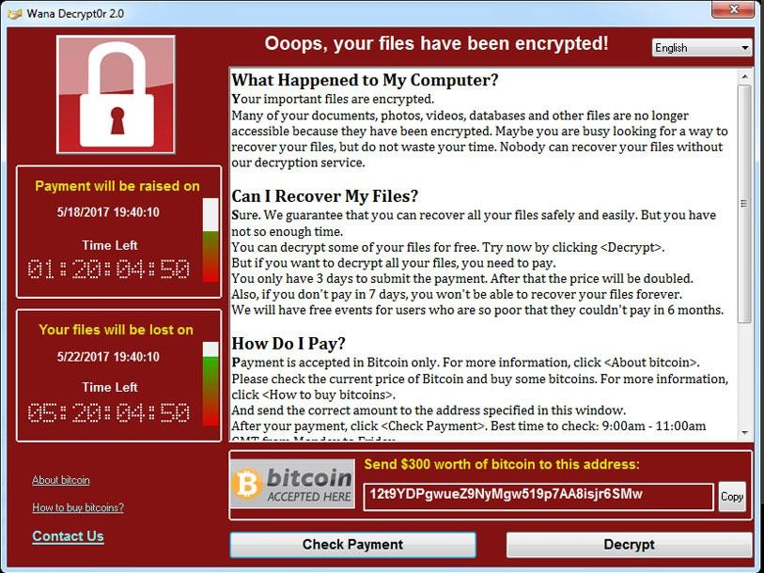
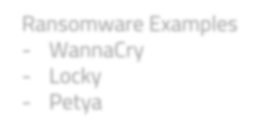

Ransomware
A malware used for the purpose of facilitating a ransom attack.
Ransomware attacks often use cryptography to “lock” the files on an affected computer and require the payment of a ransom fee in return for the “unlock” code.
Ransomware Examples
Ransomware attackers often use social engineering techniques, such as phishing, to gain access to a victim’s environment.
WannaCry
Locky
Petya

Slide 9

Threats Identification and Prevention Tools
⦿ System Hardening
The process of securing a system by reducing its surface of vulnerability
Examples:
Disable unused services and ports
Only install needed applications
System updates and patch management
Session time-out
Password management
⦿ Security Solutions
Technological tools and services that help protect organizations against cyber attacks
Examples:
Firewalls (Host/Network based)
IDS/IPS (Host/Network based)
DLP (Host/Network based)

Slide 10



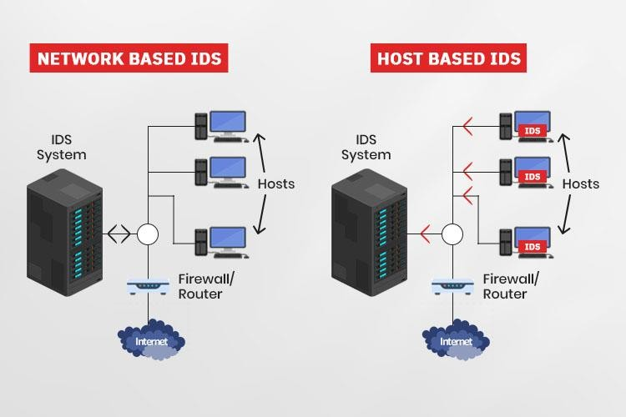

Security Solutions to Detect/Prevent attacks
Detection Only
Intrusion Detection System (IDS)
An Intrusion Detection System is a device or software application that monitors a network or systems for malicious activity or policy violations
Host based (HIDS)
Network based (NIDS)

Slide 11


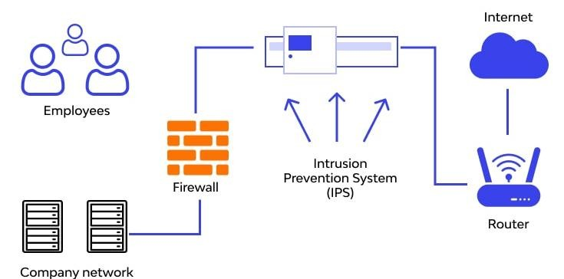
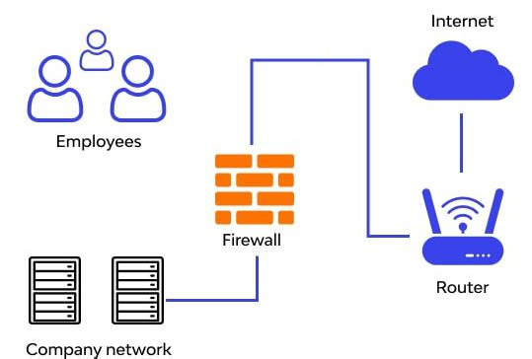

Security Solutions to Detect/Prevent attacks
Detection & Prevention
Intrusion Prevention System (IPS)
An Intrusion Prevention System is a device or software application that monitors a network or systems for malicious activity or policy violations and blocks it
Host based (HIPS)
Network based (NIPS)
(NIPS)
(HIPS)

Slide 12




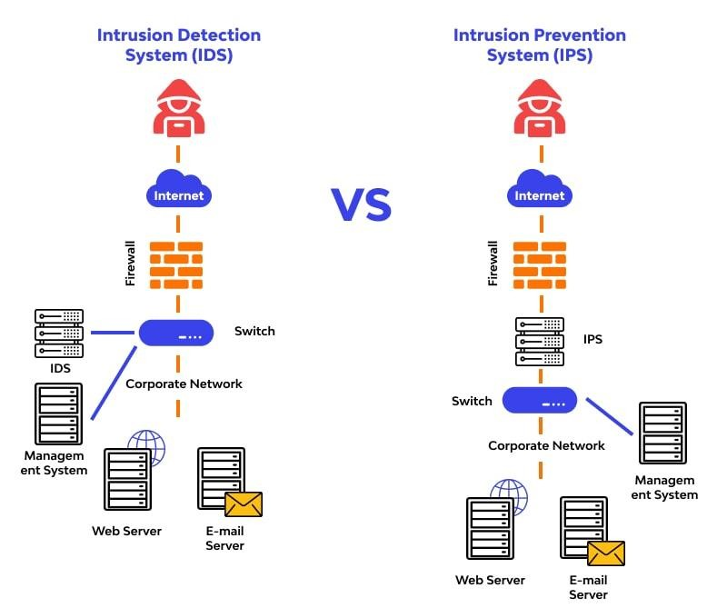





IDS IPS
IDS
IPS

Slide 13
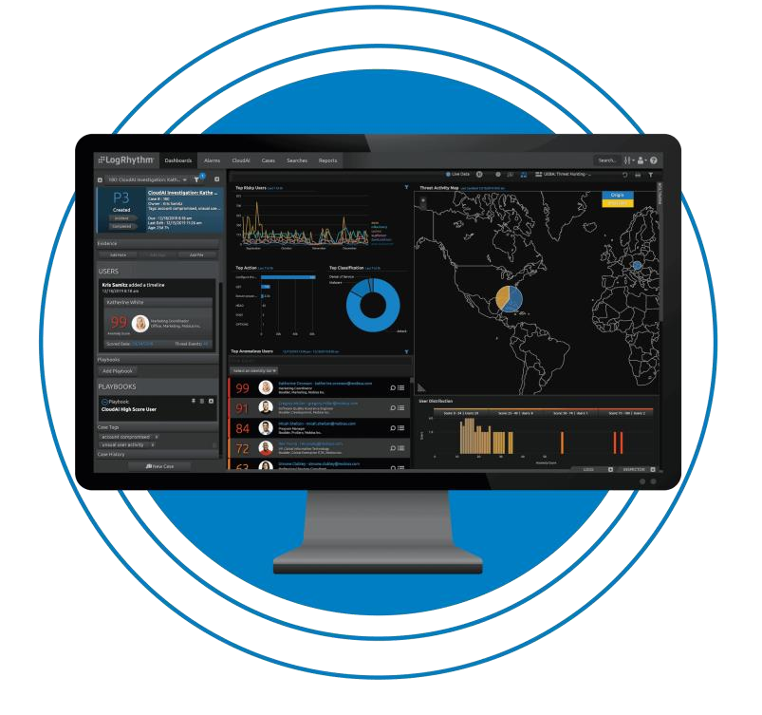

Security Solutions to Detect/Prevent attacks
Detection & Reporting
Security Information and Event
Management (SIEM)
A solution that helps organizations to efficiently collect, detect, analyze log data, and respond to security threats before they harm business operations

Slide 14



Security Solutions to Detect/Prevent attacks
Antivirus/Antimalware
An antivirus product is a program designed to detect and remove viruses and other kinds of malicious software from your computer or laptop. Malicious software - known as malware - is code that can harm your computers and laptops, and the data on them.

Slide 15

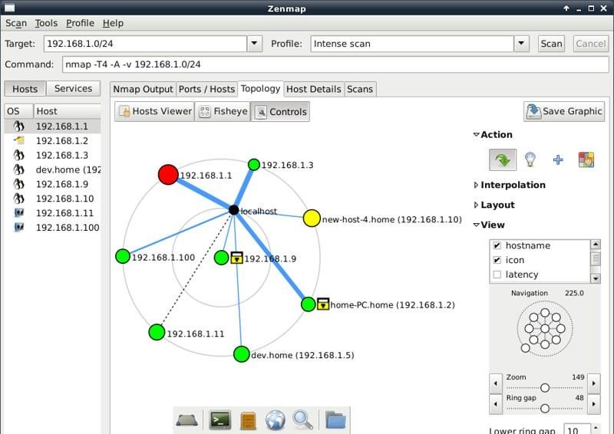

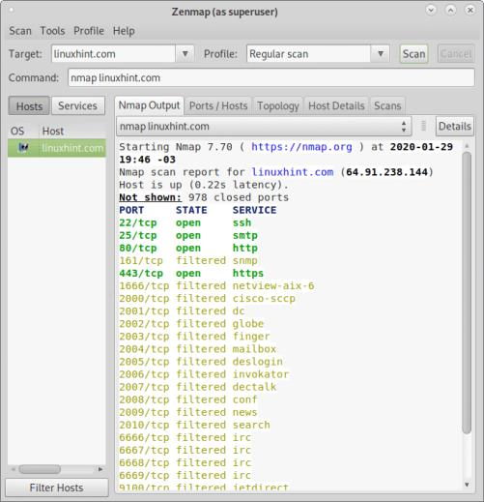

Security Solutions to Detect/Prevent attacks
Scanners
Zenmap is a graphical user interface for Nmap. It is a free and open-source software that helps you get up and running with Nmap. In addition to providing visual network mappings, Zenmap also allows you to save and search your scans for future use.

Slide 16




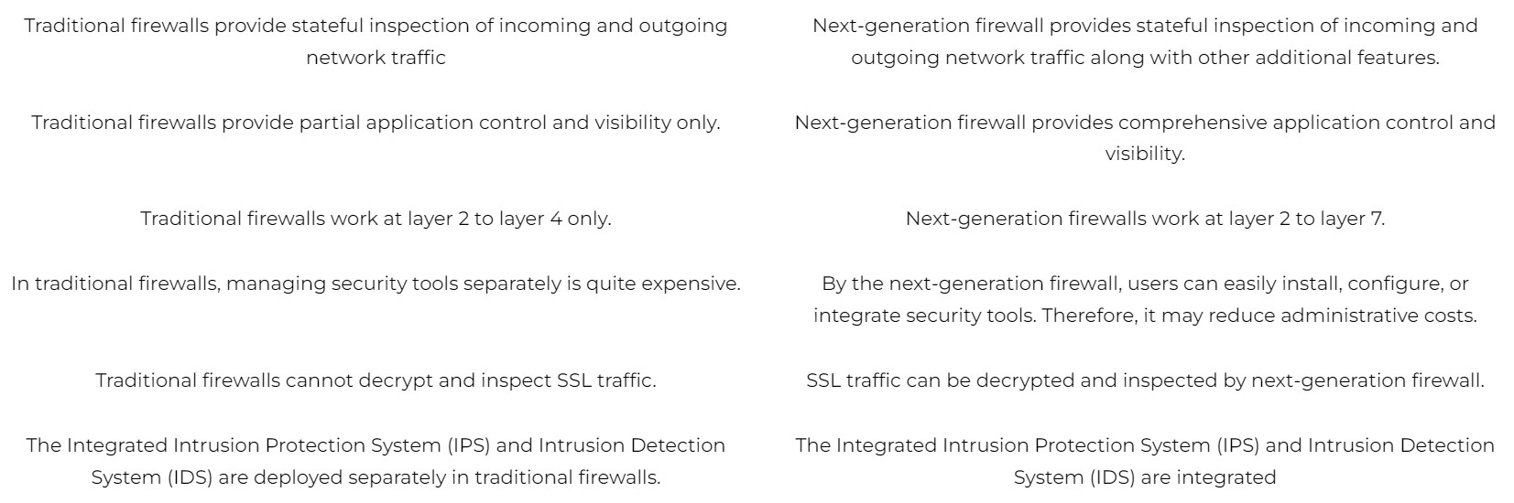

Firewalls
Traditional Firewall
Next-Generation Firewall

Slide 17




